Slide 1
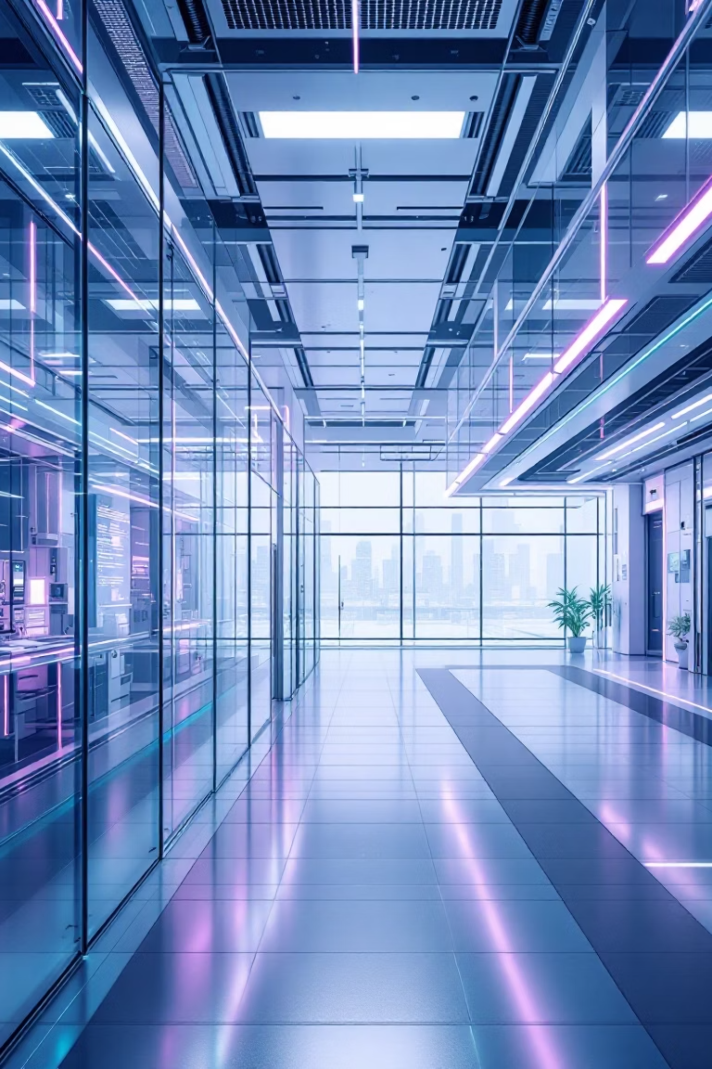
How AI Could Help Stretch the Life of Industrial Equipment
AI Agents Transforming Maintenance through IBM's Maximo Application Suite

Slide 2

The Shift from Reactive to Proactive
Traditional Fixed Schedules
Condition-Based Maintenance
Like changing your car's oil every 3,000 miles regardless of actual condition—maintenance happens on a rigid timeline, often too early or too late.
Monitor actual equipment health through sensors and data—service only when needed, preventing failures before they happen.
Wastes resources on unnecessary service
Data-driven decision making
Misses critical issues between intervals
Prevents unexpected breakdowns
One-size-fits-all approach
Optimizes resource allocation

Slide 3

IBM Maximo: Four Decades of Asset Intelligence
01
02
1984: Foundation
Sensor Integration
Platform launched for physical asset management across industries
Evolved to incorporate real-time equipment monitoring and inspection data
03
AI Revolution
Now powered by intelligent agents that predict, optimize, and prevent failures
Today, Maximo manages millions of assets globally, from manufacturing plants to energy facilities, transforming how organizations maintain critical equipment.

Slide 4
The Costly Problem with Fixed Schedules
Resource Waste
Unexpected Failures
Shortened Lifespan
Premature maintenance on healthy equipment drains budgets and labor hours unnecessarily
Critical breakdowns occur between scheduled checks, causing production losses and safety risks
Without data-driven insights, machines age faster and replacements happen too frequently
Enterprises need intelligent systems that extend equipment life through predictive analytics—not guesswork based on calendar dates.

Slide 5




AI Agents: The New Brain of Maximo
Traditional Approach
Schedule-driven maintenance at fixed intervals
AI Integration
IBM Research agents analyze patterns and conditions
Predictive Power
Anticipate failures before they impact operations
This evolution represents a fundamental shift—from reacting to equipment problems to preventing them through artificial intelligence.

Slide 6




Meet the AI Agent Team
Maximo Assistant
Condition Insights Agent
LLM-powered chat interface lets teams query asset data conversationally—ask questions in plain language, get instant insights about equipment status and history.
Analyzes continuous sensor streams—vibration, temperature, pressure—to detect anomalies and predict equipment health degradation before failure occurs.
Optimizer Agent
Future Investment Agent
Recommends optimal replacement timing by balancing budget constraints, performance requirements, and total cost of ownership across your asset portfolio.
Coming 2026: Long-term capital planning that factors in lifecycle costs, sustainability goals, and evolving operational needs.

Slide 7
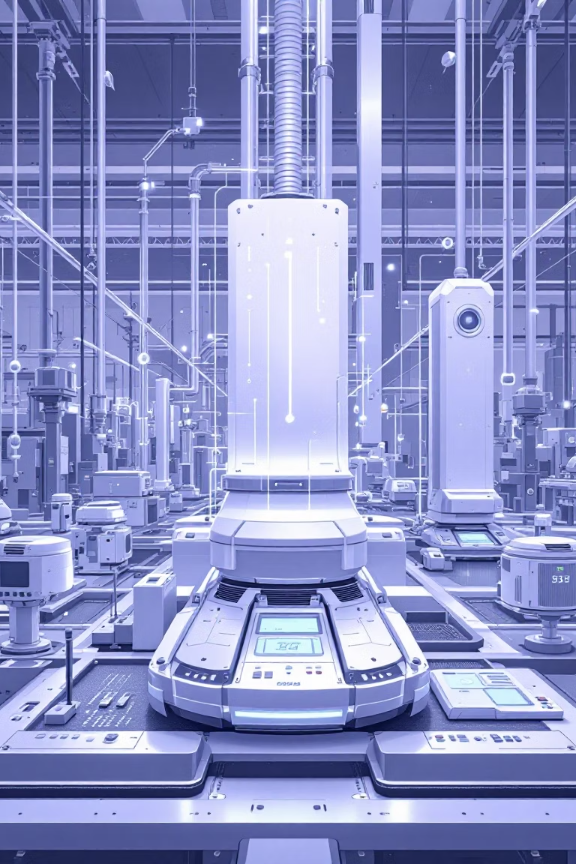

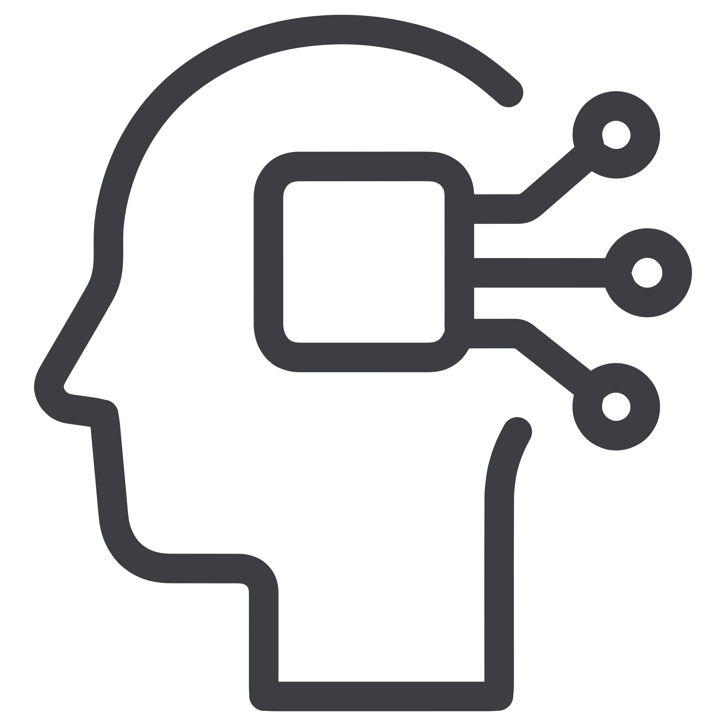

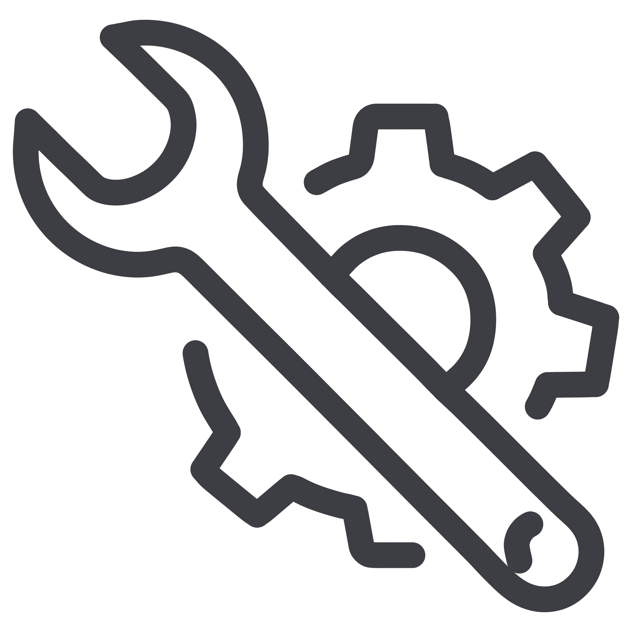
How the System Works
Data Collection
Sensors capture vibration, temperature, acoustics, and performance metrics in real-time
AI Analysis
Machine learning models identify patterns, anomalies, and degradation trends
Predictive Alerts
System generates failure predictions with confidence scores and timelines
Proactive Action
Maintenance teams intervene before breakdowns—preventing costly downtime

Slide 8




Innovation Under the Hood
Granite 4.0 Foundation Model
Time-Series Foundation Models
AssetOpsBench Platform
State-of-the-art language model integration powers natural language queries and contextual understanding of complex asset data and maintenance procedures.
Specialized neural networks detect subtle patterns in sensor data over time, identifying degradation signatures invisible to traditional analytics.
Open-source benchmark environment enables researchers and developers worldwide to test, improve, and contribute to asset management AI agents.

Slide 9
The Future Is Predictive
Lower Maintenance Costs
Reduced Downtime
Eliminate unnecessary service and focus resources where truly needed
Prevent unexpected failures that halt production and revenue
Extended Equipment Life
Sustainability Gains
Optimize performance to maximize asset lifespan and ROI
Reduce waste, energy consumption, and environmental impact
As AI agents become more sophisticated and collaborative, we're moving toward fully automated asset management ecosystems where machines maintain themselves intelligently. Through open platforms like AssetOpsBench, the entire industry can accelerate this transformation together.
Prevention is better than cure. AI makes proactive maintenance not just possible—but practical at enterprise scale.

